Slide 1
ELDERLY ABUSE
Name:
Course:
Professor:
Date:

Slide 2
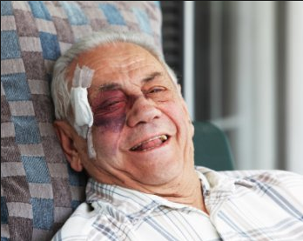
Introduction
Elderly abuse is the lack of appropriate action which causes harm to the old person. This includes the harm of older persons whom they have relationship with such as grandfathers and grandmothers. Around 1 in 6 elder people are abused. This is common in older people living in institutions than in community (Staff, 2017).

Slide 3
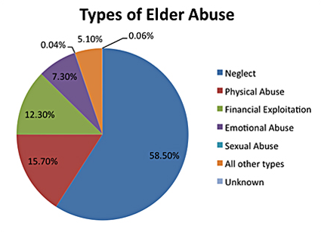
Types of Elderly Abuse

Slide 4
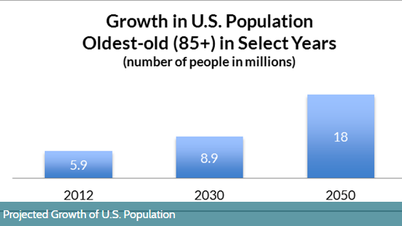
Elderly population demographics in the USA
Elderly population is defined as the age of 65 and over. The elderly depend on their younger relatives who are between the age of 15-64 years and commonly working (Glasgow & Berry, n.d.).
The elderly people tend to be concentrated in the rural and urban communities. Due to their dependency nature, the elderly population affect spending in pensions, healthcare, welfare, education which affects the government and the family in general (Staff, 2017).

Slide 5
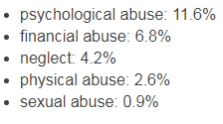
Scope of the problem
Elderly abuse is an important health problem in the US. 15.7% of the elderly people are aged 60 years and above. Out of every 24 cases of elderly abuse, only 1 is reported. The elderly are afraid to report their family members, friends, siblings in case they are abused (Hackler, 2014).
Elderly abuse leads to physical injuries leading to bruises, broken bones, head injuries or even total disability. This becomes a burden to the government whop finance their welfare (Hackler, 2014).

Slide 6
Effects of the problem
The main impacts of aging population include;
Increase in dependency ratio
When life expectancy increases, pension schemes for elderly become a burden to the economy and tax payers. The shrinking workforce also affects income.
2. Increased government spending on pensions, healthcare brings about debt issues. Once harmed the government takes care of the expense
3. Health care
Assisted homes for elderly must be available for the elderly. This affects the economy since they need care and funding must come from the tax payers money. Continued stay in the assisted homes is expensive for the economy. This affects public health since the healthcare concentrates on treating harmed elderly people, psychologically abused people, sexually abused and financially abused (Giacalone, 2017).

Slide 7
Prevention of elderly abuse
Public and professional awareness campaigns
Screening (of potential victims and abusers)
School-based intergenerational programmes
Caregiver support interventions (including stress management and respite care)
Residential care policies to define and improve standards of care
Caregiver training on dementia (Staff, 2017).

Slide 8
Reference
Giacalone, J. A. (2017). The US nursing home industry. Armonk, NY [u.a.: Sharpe.
Glasgow, N., & Berry, E. H. (n.d.). Rural Aging in 21st Century America [recurso electrónico].
Hackler, C. (2014). Health care for an aging population. Albany, NY: State Univ. of New York Press.
Staff, N. R. C. (2017). Aging Population in the Twenty-First Century: Statistics for Health Policy. Washington: National Academies Press.

